Slide 1
Motivation and Emotion

Slide 2
What is Motivation?
The word Motivation is derived from Latin word “Movere” which means to move, thus motivation is a force which makes a person to move or behave in a particular way.
Motivation is a need or desire that energizes behavior and directs it toward a goal. It is what either starts or stops behavior. It is the internal and external forces that drive our thoughts, moods, and behaviors.

Slide 3
inter-related terms
Motive:
It is the inner state that energizes, activates and directs behaviour toward goals. Motive arises out of the needs of individual e.g the need of food such as hunger motive, thirst motive.
Motivation:
It is the process of stimulating people to action to accomplish upon satisfying needs of people.
Motivator:
It is the technique used to motivate people
e.g bonus , promotion etc.

Slide 4
Motivation
Extrinsic Motivation: type of motivation in which a person performs an action because it leads to an outcome that is separate from or external to the person. Example: Going to work for money.
Intrinsic Motivation: type of motivation in which a person performs an action because the act itself is rewarding or satisfying in some internal manner. Example: Creating a web site for fun.

Slide 5
Types of Motives
Motives can be divided into three major categories
Primary Motives
Stimulus Motives
Secondary Motives

Slide 6
Primary Motives
Primary Motives are based on biological needs that must be met for survival. They are innate like hunger, thirst , pain avoidance, needs for air, sleep, elimination of wastes, and regulation of body temperature.

Slide 7
Stimulus motives
Stimulus motives: express our needs for stimulation and information. For example, activity, curiosity, exploration, throwing parties, surf the net, reading, hanging out with friends, emailing each other. Imagine what your life would be like if you felt no arousal? No stress? BORING!

Slide 8
Secondary motives
Secondary motives: based on learned needs, drives, and goals. Helps explain many human activities like making music, creating a web page, trying to win a skateboarding contest or American Idol.
These motives are related to learned needs for POWER, AFFILIATION,(the need to be with others ), approval, status, security, and achievement.

Slide 9
Examples
Primary Motives ( like satisfying hunger)
Stimulus Motives ( like learning computers or dancing for fun )
Secondary motives ( motivated to do something for fame, power, approval status)
What motives do these activities belong to?
Reading history for pleasure
Hunger
Trying out for singing competition.

Slide 10
Different Theories on Motivation
Different schools of thought look at motivation ( that power that either starts or stops behavior ) through different lenses.
Instinct theory
Drive Theory
Incentive theory

Slide 11
Instinct Theory
Instinct theory proposes that organisms are motivated to engage in certain behaviors because of their genetic programming and because these behaviors lead to success in terms of natural selection.
For example, baby crying, sucking, crawling.
nest building

Slide 12
Drive Theory
Drive Reduction or Homeostatic theory. This perspective views behavior as motivated by the need to reduce internal tension caused by unmet biological needs.
This unmet need “drives” us to behave in a way that causes the intensity of the drive to be reduced.
They work by “negative” feedback, that is one experiences an unpleasant feeling (hunger, thirst) until you meet the need.

Slide 13
Drive Theory Continued
The brain makes sure the body is kept in balance ( body temperature, fluid levels, energy supplies, need for rest ).
This balance or optimal state is called homeostasis. This is our natural state. The body does its best to stay balanced.( hunger, thirst, sex drive, sleep )
However, how do we account for eating disorders?

Slide 14
Incentive Theory
Incentive theory states that behavior is motivated by the pull of external (outside ) goals such as rewards.
You come to class to get an A
You work out to get compliments
You go to work to earn money to buy a house
Are all human behaviors motivated by incentives? What do you think?

Slide 15
Cont,,,
Not all of human behavior has a direct reward attached to it. For example, how about those who are motivated to achieve just for the sake of achieving or who do things for fun or personal growth.
What are some of the things we do for fun that don’t have any incentive attached to them?

Slide 16
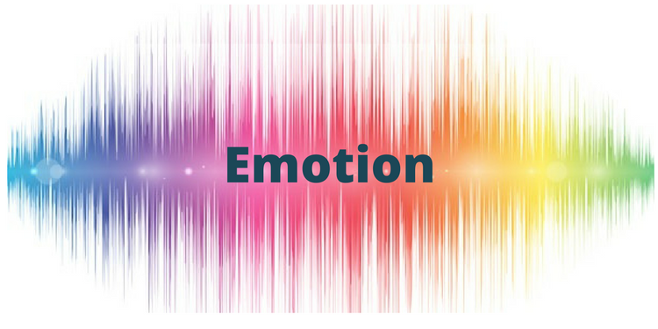

Slide 17
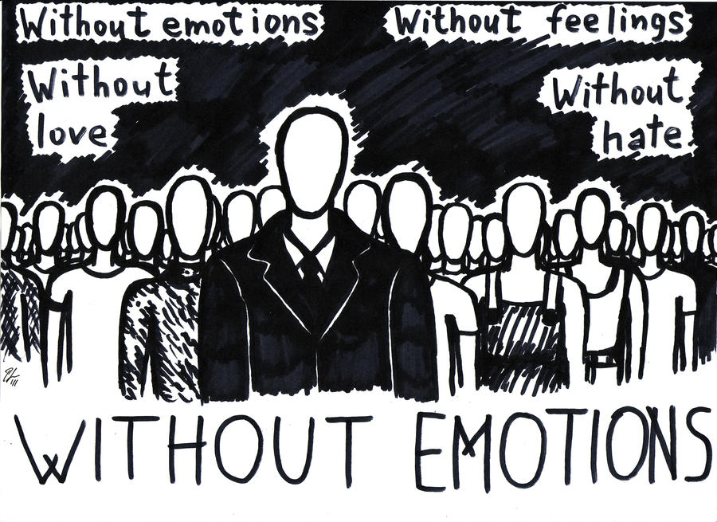

Slide 18
Importance of emotion
Emotions can play an important role in how we think and behave. The emotions we feel each day can compel us to take action and influence the decisions we make about our lives, both large and small. In order to truly understand emotions, it is important to understand the three critical components of an emotion.
There are three parts to an emotion:
A subjective component (how you experience the emotion)
A physiological component (how your bodies react to the emotion)
An expressive component (how you behave in response to the emotion).
These different elements can play a role in the function and purpose of your emotional responses

Slide 19
Emotions
. “Emotion is motivated condition remarked by physiological arousal, expressive behavior, and cognitive experiences” (Sdorow, 1993).
Emotion is defined as a state characterized by physiological arousal, changes in facial expression, gestures, posture and subjective feelings.
An example of physiological changes ( or arousal ) are a pounding heart, sweating palms, “butterflies in the stomach”, and other bodily reactions.

Slide 20
Categories Of Emotions
Emotions Are Divided Into Two Categories 1)Primary emotions
A primary human emotion types are the one triggered in response to an event

Slide 21
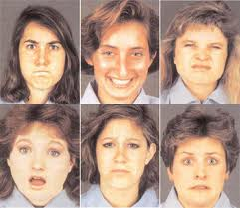
Primary Emotions
Fear
Surprise
Sadness
Disgust
Anger
Happy

Slide 22
2) Secondary Emotions
If we experience fear , the secondary emotions would be : feel threatened or feel anger , depending on the situation we are experiencing.
Secondary Emotions
Passion
Optimism
Irritation
Disgust
Shame
Nervousnes

Slide 23
Variety Of Emotions
Positive human emotions
Positive emotions that lead one to feel good about one’s self will lead to an emotionally happy and satisfied result.
Some of the positive emotions are
Hopeful ,Confident , Peaceful
Negative human emotions
Negative emotions sap your energy and undermine your effectiveness. In the negative emotional state, you find the lack of desire to do anything.
Some of the negative emotions are
Exhausted, Panic

Slide 24
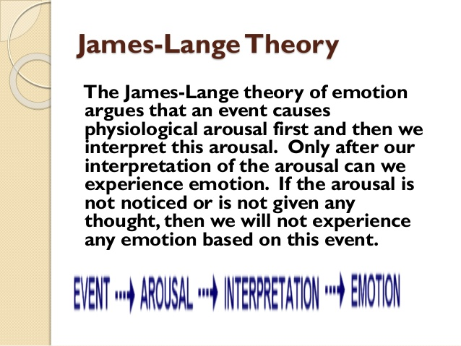
THEORIES OF EMOTIONS

Slide 25
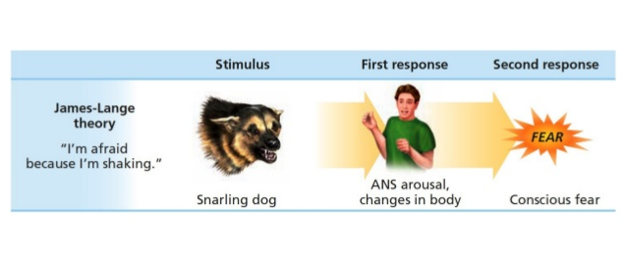
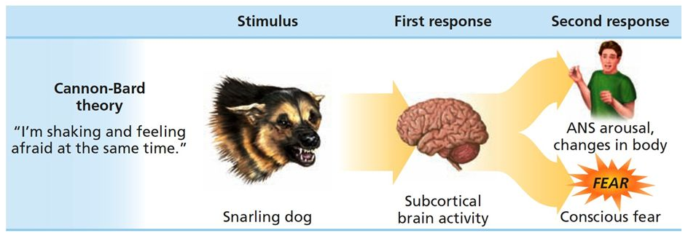

Slide 26
Cannon-bard theory of emotion
It states that we react to a stimulus and experience the associated emotion at the same time. we feel emotions and experience physiological reactions such as sweating, trembling and muscle tension simultaneously.
For example: I see a snake --> I am afraid --> I begin to tremble.

Slide 27
